Slide 1
Ride-Sharing Apps and Alcohol-Related Traffic Fatalities
Presented by: Jonathan Rico, Nicholas Dao, Robert Hascall, Ronnie Khatib, Roy Jiang, Stephanie Tran
UCI DATA ANALYTICS : PROJECT 1
Notes:
Hello all, Myself along side ….. will be going over our findings related to the release of ride-sharing apps and alcohol-related traffic fatalities.

Slide 2
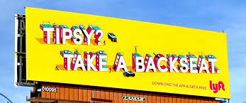
Background
UNDERSTANDING THE RISE OF RIDESHARING SERVICES
According to data from the Highway Traffic Safety Administration, alcohol is a major factor in roughly one in three traffic fatalities.
Ridesharing companies, in particular, have emphasized the potential of their services to contribute to public safety, especially concerning drunk driving.
Uber and Lyft and their competitors argue that ridesharing services fill gaps in existing transportation networks by providing cheaper, on-demand alternatives to taxis and public transportation in traditionally underserved neighborhoods.
Notes:
Intoxicated driving, at large, proves to be one of the top causes of car fatalities. In our research, we’ve decided to analyze data sets of Ride-sharing apps in an effort to understand if they’ve proven to fill the gaps in existing transportation networks like taxis & public transportation. Uber and Lyft are the 2 most widely known ride-sharing apps in the country today, and we will utilize data sets from these ride-sharing apps to identify if they have contributed to the reduction of drunk driving fatalities.
Intoxicated driving is responsible for 1 in 3 traffic fatalities. Ride-sharing apps, like uber and lyft, have emphasized that the use of their services will aid in reducing the number of drunk driving fatalities.
Ride-sharing apps can be seen as a form of public safety, in reducing the number of drunk driving fatalities.
We will be addressing the following Proposal questions:
· Has the release of ride-sharing apps/services contributed to the reduction of drunk-driving related incidents?
· Is there a correlation between drunk-driving incidents and the use of ride-sharing app/services during holiday periods?
· Is there a metro vs. rural correlation between increased or reduced drunk driving incidents (based on ride-sharing service availability).
· Is there a correlation related to crashes by vehicle type?
o Total number of car crashes
o Fatality crashes by vehicle type

Slide 3
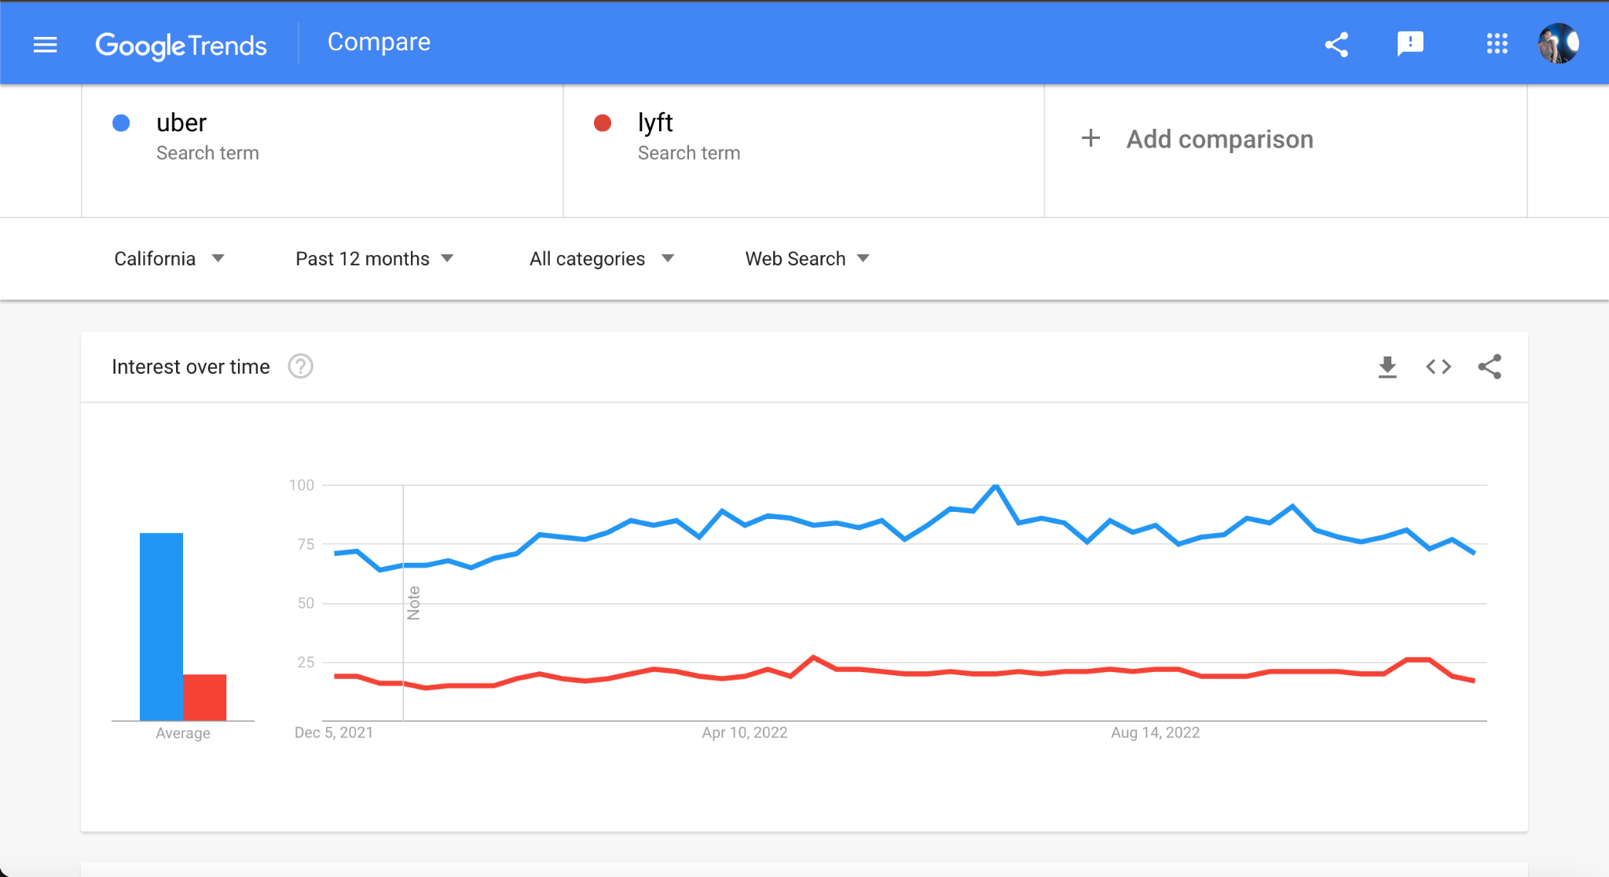
MARKET LAUNCH
Our first study uses data from Google Trends to approximate usage of Uber and Lyft across CA rural and urban counties.
Google Trends tracks the relative popularity of a search interest.
Results were from 2013-2019. Ridesharing apps were launched early 2009/2011 depending on city and started to gain traction in 2013.
Notes:
We’ll be starting off with data gathered from Google Trends.
This approach is to assess whether ridesharing services such as Uber and Lyft penetrate the market instead of a simple market presence.
Google Trends actually tracks the relative popularity of a search interest - it’s like their “popularity hits” based on location and time.
In this project, we focused on California because the state varies from its inland rural counties such as Placer and Shasta as well as the large metro counties such as LA and San Francisco.
2013 to 2019 were the years analyzed because we wanted to see a time frame of 8 years before the app (which will be later presented) and 8 years after the app developed. Lyft in 2012 and Uber in 2009.
So before we get into the data regarding fatalities post app and the impact, let’s see how ridesharing appts - Uber and Lyft were in these CA counties

Slide 4
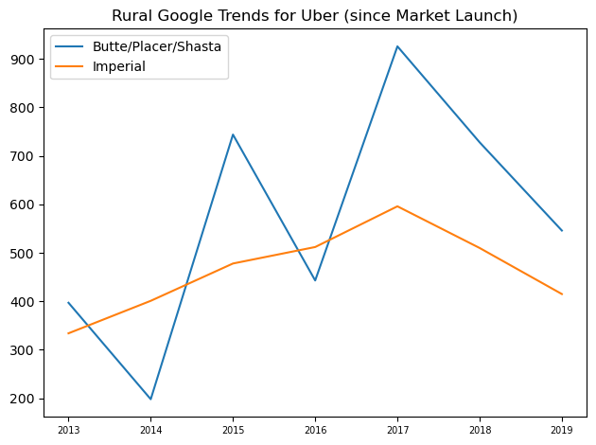
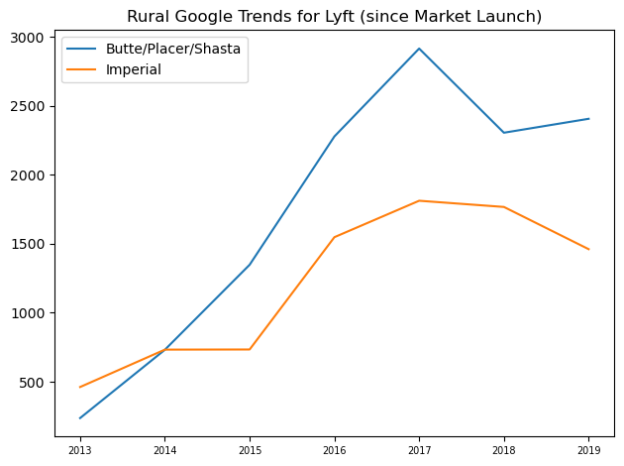
Market Launch - Rural
searches
searches
year
year
Notes:
So how popular were ride sharing apps in rural areas? Were they as accessible? Could rural areas be less likely to utilize ridesharing apps due to the region being less populated or its lack of technologic dependency?
As you can see here, when Uber was introduced to rural communities such as Butte/Placer/Shasta and Imperial Counties the google trend data was cumulative because data was very low. The rural areas were not early adopters of ridesharing (as some cities were launched a year or two after urban cities) therefore interest in the apps were not as popular. Uber peak interest was in 2017 with 900 popular search interests and Lyft in 2017 with almost 3000 hits and continue to decrease for Uber and fluctuate for Lyft (this may be due to other factors like payouts for drivers, sexual harassment case involving Uber, business accounts, etc.).

Slide 5
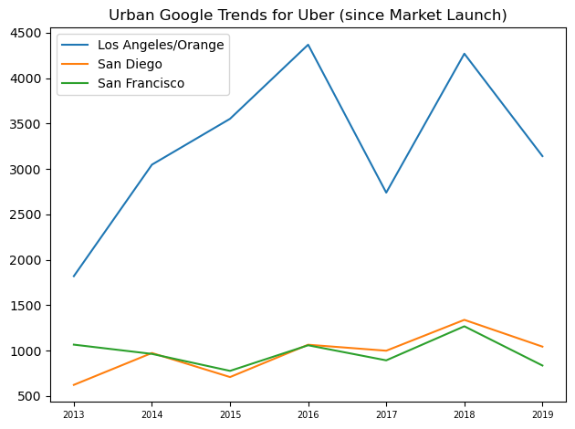
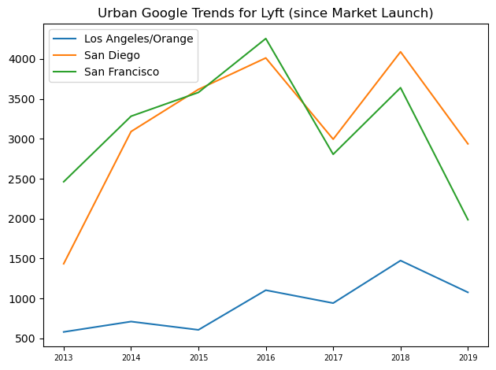
Market Launch - Urban
searches
searches
year
year
Notes:
URBAN
LA/OC and SF were early adopters of the apps and their popular interest was a lot more than the rural counties, with interest >4000 searches and sometimes up to 4500 searches..

Slide 6

KEY FINDINGS
Rural counties (Butte/Placer/Shasta, Imperial) were not early adopters of rideshare services and continue to not be big participants in the service.
Lyft seems to have higher interest in rural areas (2017-2019) and that is due to their expansion model of reaching out to less denser populations.
Urban counties (Los Angeles/Orange, San Diego, San Francisco) were participants in the early adoption of rideshare services as communities embraced rideshare services quickly and easily.
Notes:
Rural counties (Butte/Placer/Shasta, Imperial) were not early adopters of rideshare services and continue to not be big participants in the service.
Research has shown that this may be due to technological infrastructure (with shoddy internet service) and less of a desire to adopt the ride-hailing ways like city folks do.
Lyft seems to have higher interest in rural areas (2017-2019) and that is due to their expansion model of reaching out to less denser populations.
Uber was highly successful in LA/Orange County first and a year later Lyft launched successfully in San Diego and San Francisco.

Slide 7
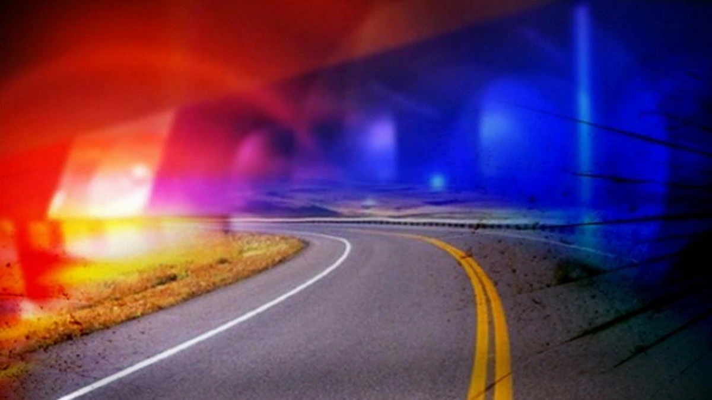
HOLIDAY FATALITIES
Our next study uses data from National Highway Traffic Safety Administration (NHTSA) to determine trends in alcohol-related automobile fatalities, over holiday periods, before (2002-2008) and after (2013-2019) the launch of ride-share services.
Data collected from the NHTSA show tracked holidays for alcohol-related fatalities to include New Year’s Day, Independence Day, Thanksgiving, Labor Day and Memorial Day.

Slide 8
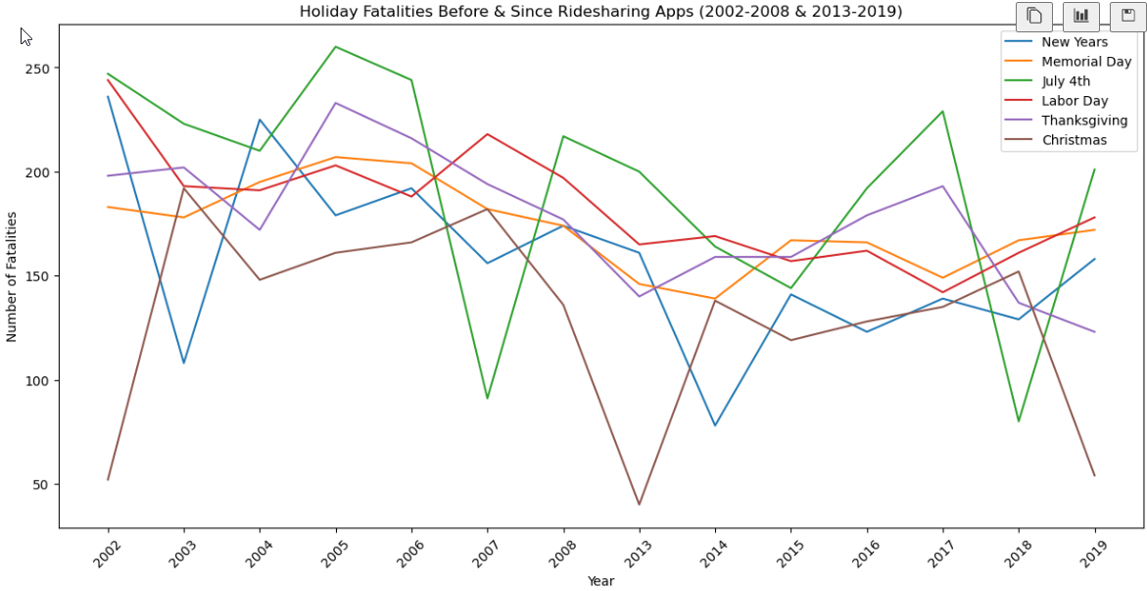
Holiday Fatalities
Overall, the data show crests and troughs since 2002 through 2019, before and after ride-sharing apps were released, while also showing a downward trend since ride-sharing apps have been available.
Notes:
We questioned the rate of drunk driving fatalities during the holiday seasons, as we know Ridesharing apps like Uber and Lyft noticeably hike up their prices. Does an increase in rates of ridesharing apps, lead to an increase of drunk driving related fatalities? Does the holiday season, in general, see a higher number of drunk driving related incidents?
We took a number of significant holidays and analyzed data sets from before and after the release of ridesharing apps to see if there was a significant difference.

Slide 9
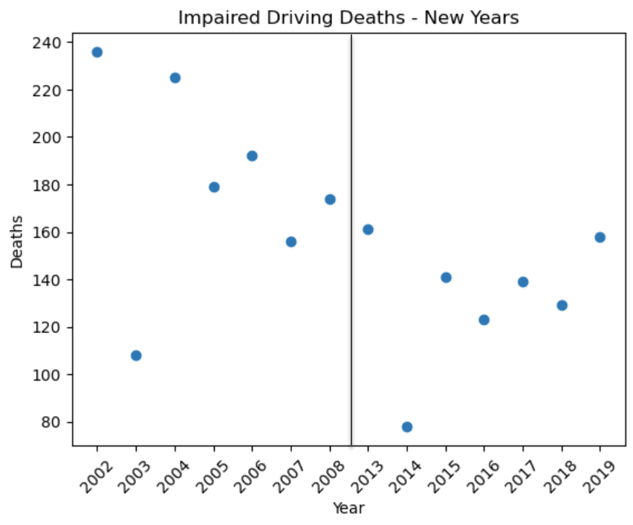
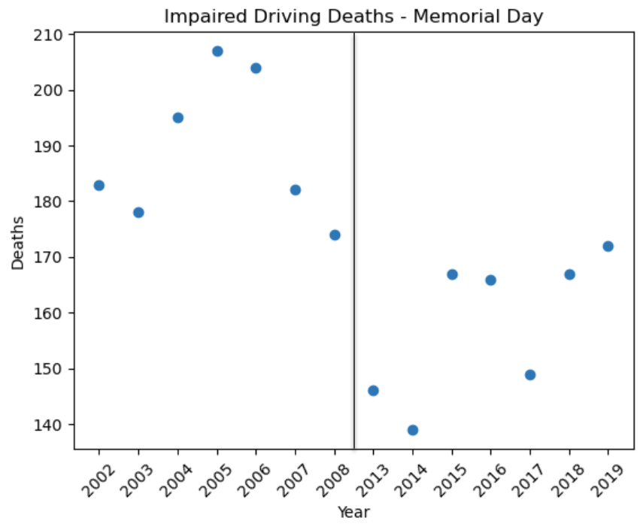
Holiday Fatalities
Average annual deaths for New Years Day decreased from 181 to 132↓.
Average annual deaths for Memorial Day decreased from 189 to 158↓.
Notes:
Here we can see the impared driving deaths before and after the release of ridesharing apps for New years and Memorial day.
Overall we see a significant decrease from the year 2002 to 2019 in inpaired driving related deaths

Slide 10
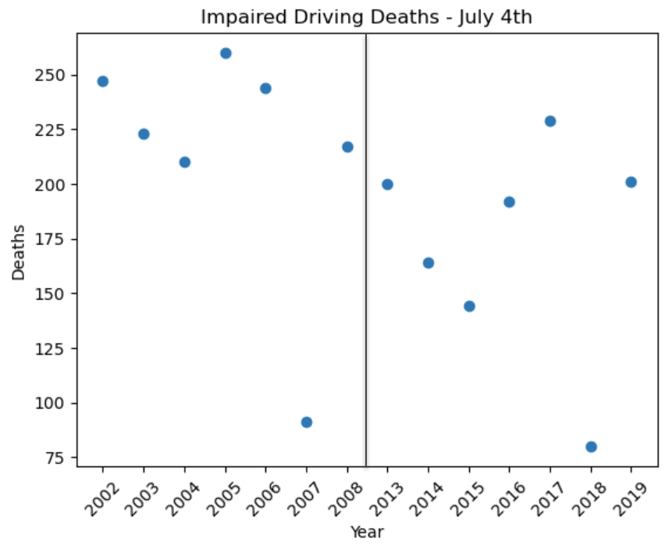
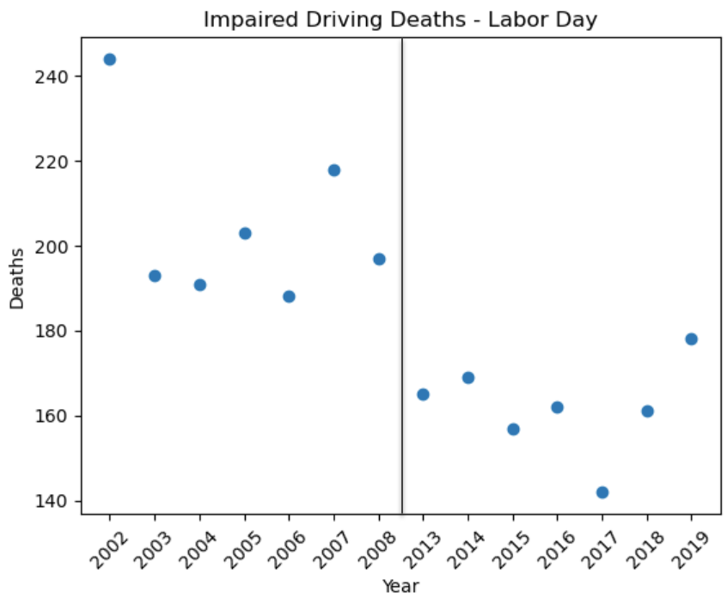
Holiday Fatalities
Average annual deaths for July 4th decreased from 213 to 172↓.
Average annual deaths for Labor Day decreased from 204 to 162↓.
Notes:
Here we can see the impared driving deaths before and after the release of ridesharing apps for July 4th and Labor day.
Most significant changes seen is the decrease on Labor day from 2002 to the year 2019.
July 4th we see some years with notable decreased rates in imparied driving deaths, like in 2007 and 2018. Although the decrease isn’t as significant as it was for Labor day, ultimately there is an overall decrease after the release of RideSharing apps.

Slide 11
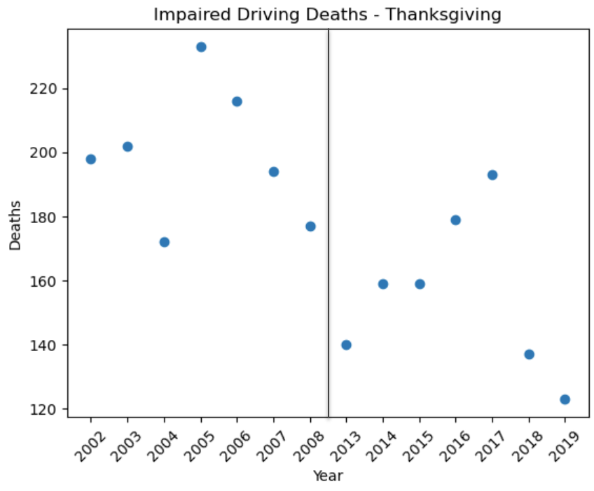
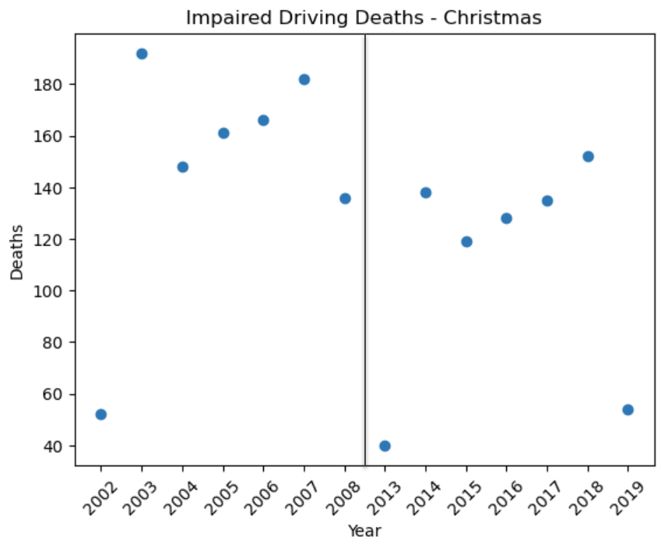
Holiday Fatalities
Average annual deaths for Thanksgiving decreased from 198 to 155↓.
Average annual deaths for Christmas decreased from 148 to 109↓.
Notes:
Here we can see the impared driving deaths before and after the release of ridesharing apps for Thanksgiving and Christmas.
For both holidays we see a significant decrease in imparied driving related deaths after the release of ridesharing apps.

Slide 12
Key Findings on Holiday Fatalities
After the release of ride-sharing apps, for all holiday fatalities, the data show an overall reduction in average deaths from 189 to 148↓ or 22%↓.
According to the data, July 4th is the most dangerous holiday for alcohol-related fatalities with an average death toll of 213 before ride-sharing apps and 172↓ after the release of ride-sharing apps.
Christmas and New Years Day saw the greatest reduction in alcohol-related fatalities with 26%↓ and 27%↓ respectively.

Slide 13
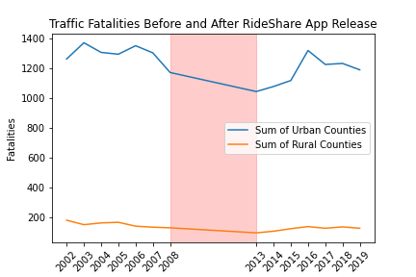
Traffic Fatalities of Urban and Rural Areas
•2002-2008: years before
•2013-2019: years after rideshare release
•Uber: 2010
-sf beta: 2009
•Lyft: 2012
Notes:
Date range 2013-2019 bc uber/lyft not fully available to counties in sample until 2013
Red rectangle = not a representation of 2008-2013
First we will analyze traffic fatality data sets before RideSharing apps like Uber and Lyft were released. In this data set we are comparing traffic fatalities in Rural and Urban areas. Rural areas are those that have less access to RideSharing apps as opposed to Urban areas. We can see that there is roughly between 1000 to 1400 traffic fatalities in Urban areas, but that makes sense given that population density in Urban areas would be greater. Rural areas sees a small but steady decline in drunk driving fatalities spanning from 2002 to 2019.

Slide 14
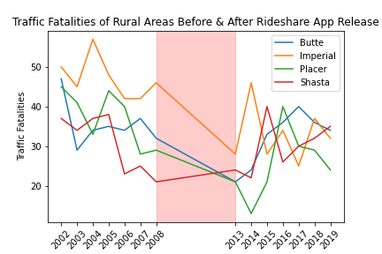
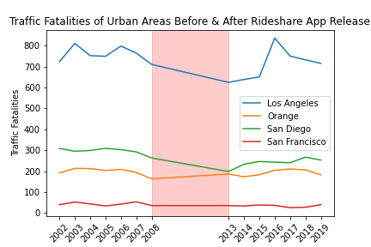
Breakdown of Traffic Fatalities by County
Notes:
Delving a bit further into detail with our datasets, we have congregated a graph that displays the range of traffic fatalities before and after to the release of RideSharing apps in both Urban and Rural cities spanning from 2002 to 2019.
In Rural counties we can see that Imperial county has the greatest number of fatalities initially, but after the release and use of ridesharing apps, the number of fatatlies goes down substantially. Placer county also sees a great decline in drunk driving related fatalities after the release of RideSharing apps.
In Urban cities, the graph congregated looks a bit different compared to the Rural areas. It seems as though there were no significant changes in the decline of drunk driving related fatalities post RideSharing apps being released. LA county sees a bit of a decline then an incline, but seems to be maintaining a steady rate of fatalities across the last decade and a half.

Slide 15
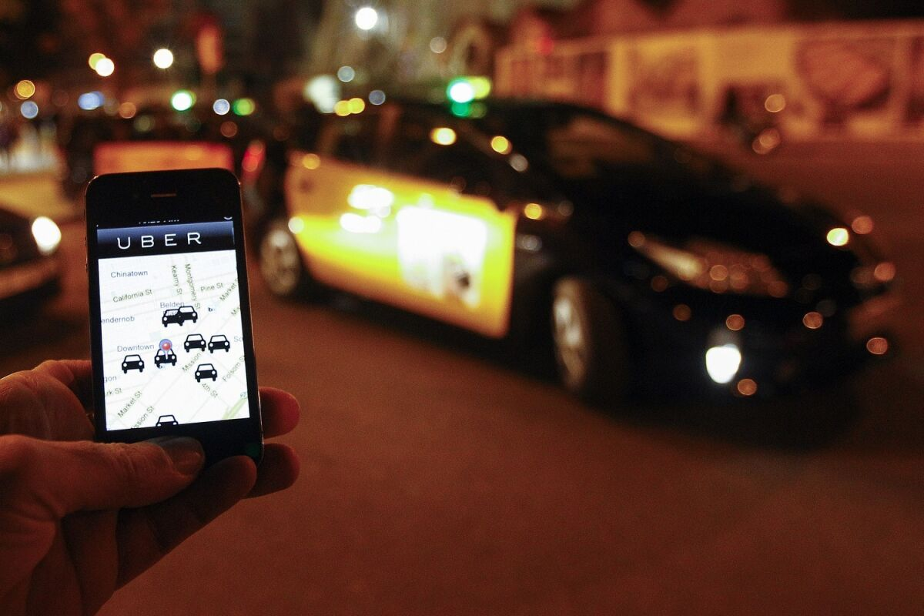
Key Findings
Traffic fatalities in urban areas have decreased in the first few years following the release of rideshare apps.
2008 vs 2013:
Urban County Sums (10%↓)
Los Angeles (12%↓), San Diego (24%↓)
2013 - 2016
Urban Counties: 26% increase
Rural counties traffic fatalities have generally stayed the same.
Butte, Imperial, Placer ↓
Notes:
Our key findings after analyzing our data-sets are reported as following;
We see an overall decline in drunk driving fatalities in Urban areas. Ranging from 2008 to 2013, we see an overall decrease sum of 10% and major counties like LA going down 12% and San Diego county going down 24% in drunk driving related fatalities.
Following the release of ridesharing apps, we see an overall increase of 26% of drunk driving related fatatlities.
Rural counties have generally stayed the same; however, we do a see a decrease in drunk driving related fataltiies in Butte, Imperial and Placer County.

Slide 16
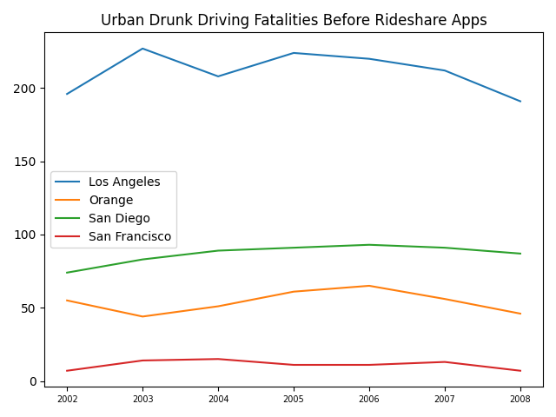
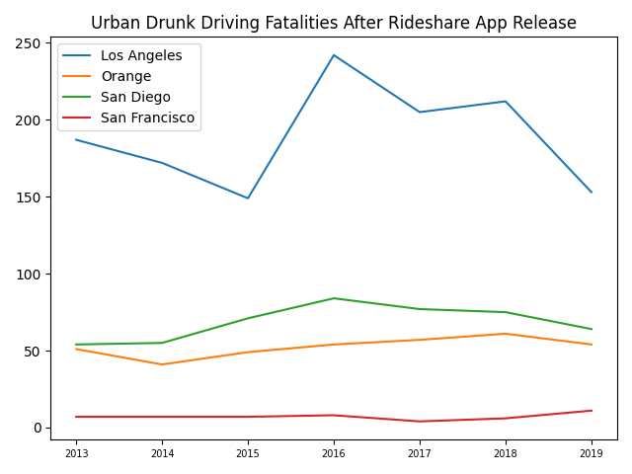
Drunk Driving Traffic Fatalities by County
Notes:
Delving a bit further into detail with Urban areas and Drunk driving fatalities, we generated graphs using our datasets with regards to Urban area rates of drunk driving fatalities.
We looked at data sets before and after the release of RideSharing apps to see if there were any differences in the rate of Drunk Driving related incidents
and if RideSharing apps proved to serve as a form public health and safety.

Slide 17
Key Findings on Urban Counties
Los Angeles County saw a decrease in drunk driving fatalities over the first three years after the release of ridesharing apps. After 2016, LA County’s drunk driving fatalities had a 60% increase in fatalities, gradually decreasing over the years.
San Diego County, after the introduction of ridesharing apps, had drunk driving fatalities decreased by about 30% during the first year, with those numbers steadily increasing, but still staying below the numbers before ridesharing apps.
San Francisco County saw a consistent decrease in drunk driving fatalities throughout the years following the release of ridesharing apps, with fatalities only increasing at the end of the timeframe the data encompasses.
Orange County saw no significant change in numbers when ridesharing apps were introduced.
Notes:
After analyzing out datasets of drunk driving related fatalities in Urban areas before and after RideSharing apps, we found a few key findings:
First, we saw an overall decrease in drunk driving fatalities within the first 3 years after ridesharing apps had been released.
However, we notice a gradual increase in drunk driving fatalities even after the release of ridesharing apps.
San Diego county initially saw a decrease of 30% in the first year, but eventually noticed a gradual increase. Still with the increase, San Diego counties drunk driving related fatalities were not as high as the initially were prior to the release of ridesharing apps.
SF county saw a small but steady decrease and OC saw no significant changes with the introduction of RideSharing apps.

Slide 18
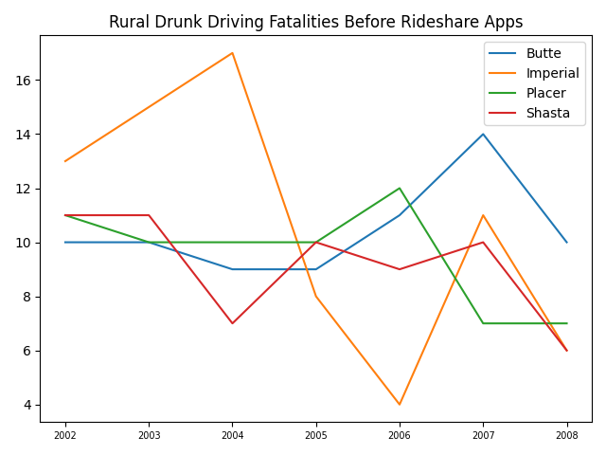
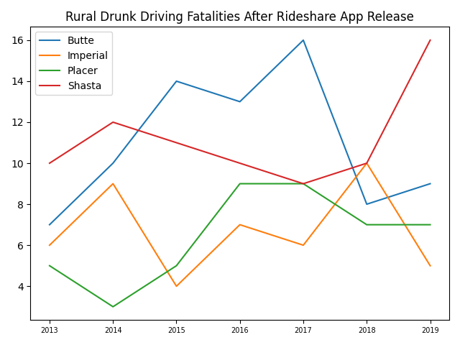
Drunk Driving Traffic Fatalities by County
Notes:
The following examines graphs generated using data sets congregated of drunk driving fatalities in Rural areas before and after the release of ridesharing apps.

Slide 19
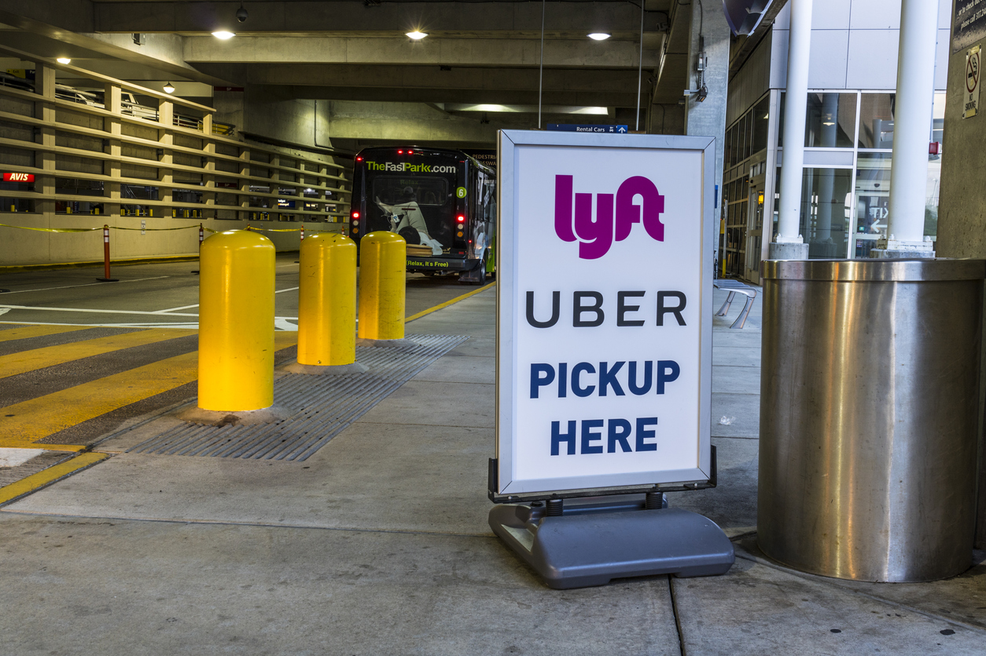
Key Findings on Rural Counties
Both Butte and Placer County saw a noticeable decrease in drunk driving fatalities during the first year the ridesharing apps were introduced, but the number of fatalities increased over the years.
Imperial County overall had a decrease in drunk driving fatalities after the introduction of rideshare apps when compared to the pre-rideshare app years.
Shasta County had an overall increase in drunk driving fatalities over the years after rideshare apps were released.
Notes:
Our key findings on Rural Counties and the rate of drunk driving incidents before & after the release of ride sharing apps is as follows:
Butte and Placer county saw an initial decrease of drunk driving fatalities following the release of ridesharing apps, but similar to urban cities, we see drunk driving fatalities pick up following the release of those apps.
Imperial county sees an overall decrease in the number of drunk driving fatalities following the release of ridesharing apps.
Shasta County sees an overall increase in the rate of drunk driving fatalities even with the release of ridesharing apps.

Slide 20
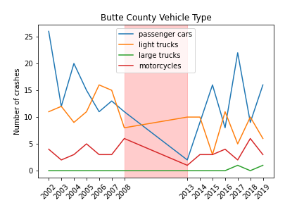
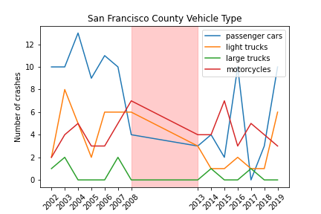
RESULT - Vehicle types (Rural areas)
Notes:
In our venture to understand whether or not RideSharing apps can attest to the decrease in drunk driving related fatalities, we delve a bit deeper into our data sets and analyze different vehicle types to get a better understanding of which types of vehicles are most likely to be involved in drunk driving related incidents.
We analyze vehicle types in both Rural and Urban areas.
Passenger cars seem to be the most likely to be involved in impaired driving related incidents in both rural and urban areas.
We see an overall decrease in the number of passenger related vehicle crashes after the release of ridesharing apps in both rural and urban regions

Slide 21
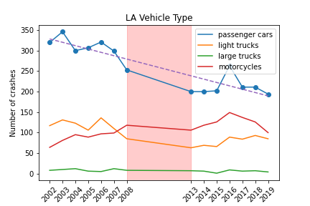
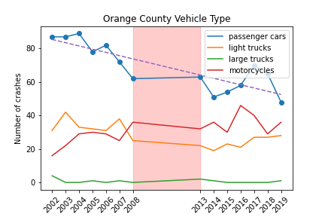
RESULT - Vehicle types (Urban areas)
The correlation coefficient between year and passenger car in LA county is -0.9
The correlation coefficient between year and passenger car in Orange county is -0.84
There is clear decreasing trend for passenger cars from urban areas after year 2013 compared with those from year 2002 to 2008 (before Uber/Lyft app launch).
Notes:
Taking it a bit further for Urban areas, we took a closer look at data sets for both LA and Orange County to see which type of vehicles are most likely to be involved in imparied driving related incidents both before and after the release of ride sharing apps.
In the diagram, it is clear to see there is a steady decrease in passenger vehicle related drunk driving incidents in both urban countys.

Slide 22
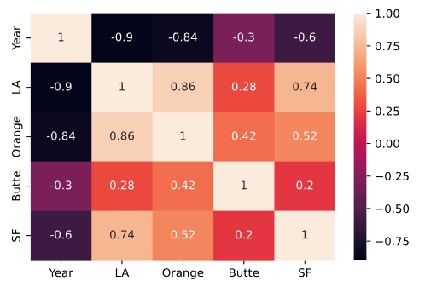
Key Findings (from the graph)
The crash cases reported all vehicle types, while Uber services were comprised of sedan/passenger cars instead of large trucks.
The amount of crashes involving only passenger cars decreased for urban areas compared with those from rural areas.
No significant decreasing trend was observed for passenger cars from rural counties.
Notes:
Our key findings from the data sets and after analyzing the graphs, we can see there is an overall decrease in drunk driving related incidents for all types of vehicles, but more specifically passenger vehicles in both rural and urban areas.

Slide 23
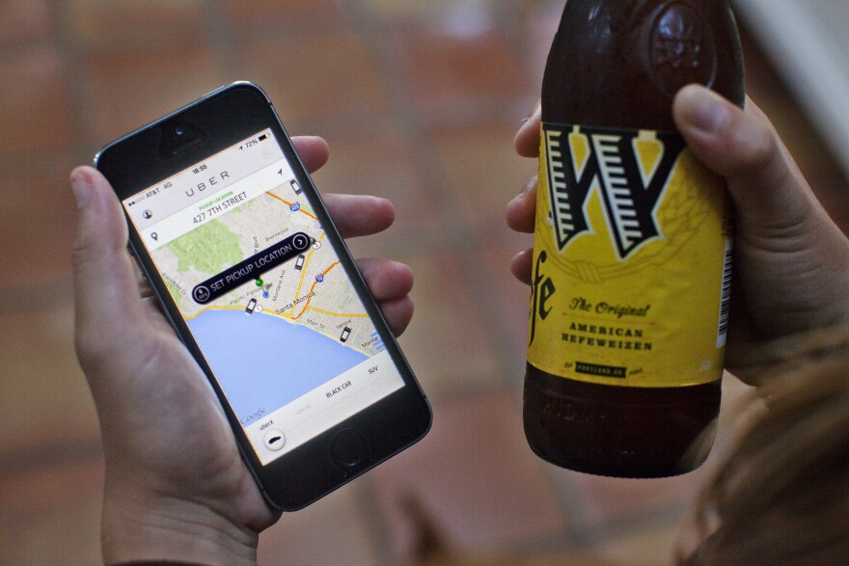
CONCLUSION
After conducting our research, we can conclude, that although there are a multitude of factors that are impossible to account for, we can see an overall decrease in the number of drunk driving related incidents after the release of ride sharing apps.
Rural and Urban areas both have seen decreases independent of the popularity urban cities may have using ridesharing apps. Rural areas seem to be just as impacted by the use of ridesharing apps and the decrease in drunk driving related incidents.
Ride-sharing apps seem to have contributed to the reduction in Holiday Fatalities, but after deeper study, there are certainly other contributing factors.
The use of Ridesharing apps as proven, to some degree, that it has filled some of the gaps that taxis and public transportation systems have left open. Being that one can utilize a rideshare app from the ease of their own fingertips, allows people to get to and from safely and not risk driving under the influence.
Notes:
After conducting our research, we can conclude, that although there are a multitude of factors that are impossible to account for, we can see an overall decrease in the number of drunk driving related incidents after the release of ride sharing apps.
Rural and Urban areas both have seen decreases independent of the popularity urban cities may have using ridesharing apps. Rural areas seem to be just as impacted by the use of ridesharing apps and the decrease in drunk driving related incidents.
Ride-sharing apps seem to have contributed to the reduction in Holiday Fatalities, but after deeper study, there are certainly other contributing factors.
The use of Ridesharing apps has proven, to some degree, that it has filled some of the gaps that taxis and public transportation systems have left open. Being that one can utilize a rideshare app from the ease of their own fingertips, allows people to get to and from safely and efficiently not risking driving under the influence.

Slide 24
References
Google Trends: https://trends.google.com/trends/explore?geo=US&q=lyft,uber
Holiday Fatalities Source: FARS 1982-2019 Final, 2020 ARF: https://cdan.nhtsa.gov/SASStoredProcess/guest
Fatalities and Fatality Rates by County, https://www-fars.nhtsa.dot.gov/States/StatesFatalitiesFatalityRates.aspx https://www-fars.nhtsa.dot.gov/States/StatesAlcohol.aspx
Vehicle Type:
https://www-fars.nhtsa.dot.gov/Main/index.aspx

